Slide 1
INSIGHTS FROM THE SCOTTISH PARLIAMENT ENGAGEMENT MODEL
Laura Black, Participation and Communities Team (PACT)
26 March 2025

Slide 2
1 How has Scotland made public engagement a core part of parliamentary procedures?
Scottish Parliament Public Engagement Strategy
- 2018 Parliamentary Reform Report – Parliamentary objective to reach seldom heard voices
Currently in review
Includes range of services
Development of PACT
PACT’s vision is to provide participation expertise to embed the involvement and impact of more diverse and missing voices in the life and work of the Parliament.
We work:
- Collaboratively across service teams,
- inhouse team facilitation,
- community development approach,
- employing range of engagement methods including deliberative,
- working towards embedding deliberative methods.
PACT
Events &
Exhibitions
PCO
MSPs
Public Engagement Services
Broadcasting
SPICe
Clerks
Visitor
Services

Slide 3
Who PACT work with - externally
Eight Regional Constituencies
Partners: Local to National
Third Sector Interfaces
Voluntary Organisations
Charities
Academics - fellowships
We work in partnership with 120-160 organisations per year.
We engage around 1000-1300 participants per year.
We deliver around 14 in person events in Parliament per year.
We deliver around 30 online events per year.
We deliver around 23 in person events in communities per year.

Slide 4
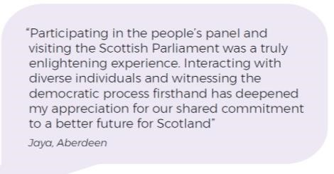
Embedding deliberative democracy and public trust
Democratic Wellbeing means that we all have a voice and choice in decisions that affect our lives.
“Scotland has a democratic wellbeing score of just 39, shaped by depleting levels of trust in MSPs and MPs, and a growing sense that people are unable to influence decision making.”
Carnegie UK: Life in the UK: Scotland 2024

Slide 5
Blueprint for embedding deliberative methods
People’s Panels
Pilots & evaluation confirm value of approach – six delivered 2018 - 2024
Commitment to a stable Session 7 (2026 – 2031) framework to maximise benefits
Wider deliberative approaches
Bringing benefits into participation more widely eg lived experience panels
Using learning to improve quality of scrutiny and public discussion

Slide 6
Embedding deliberative methods

Slide 7
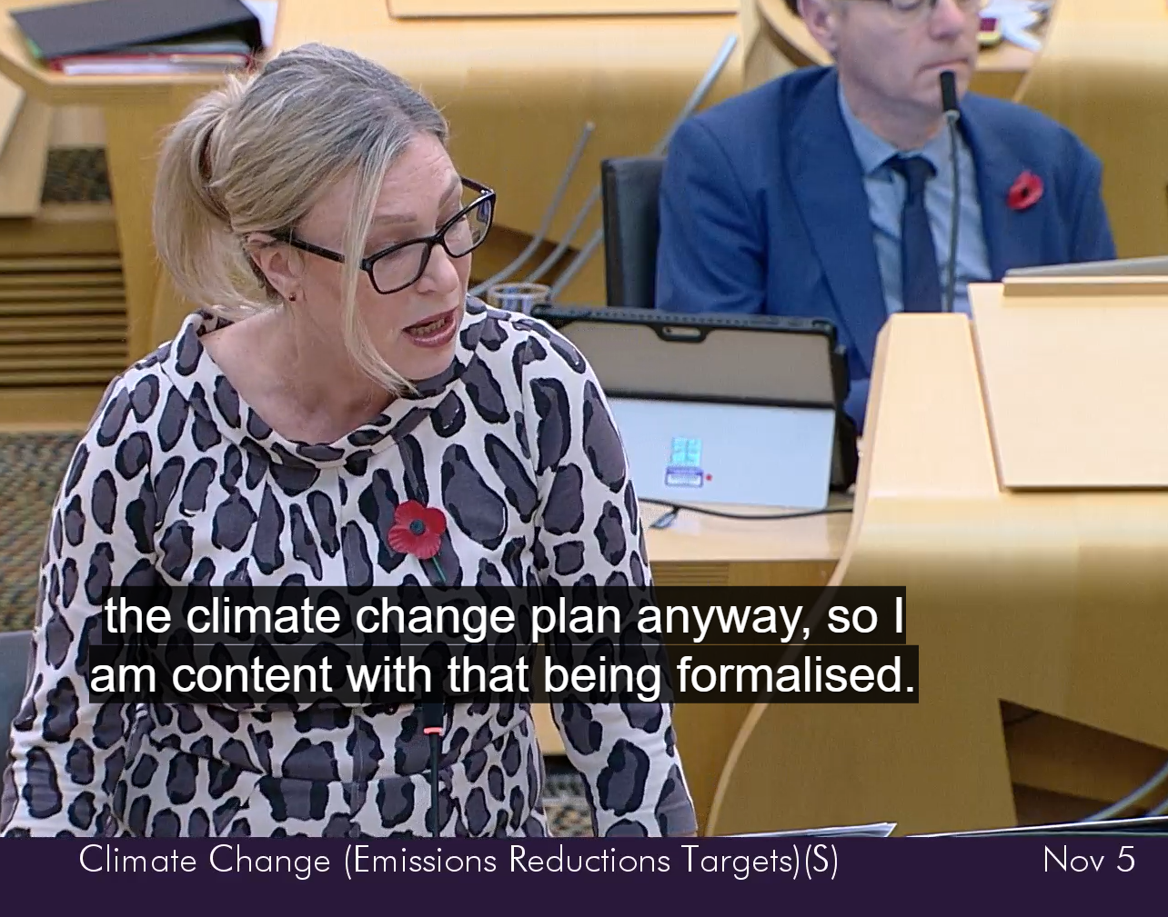
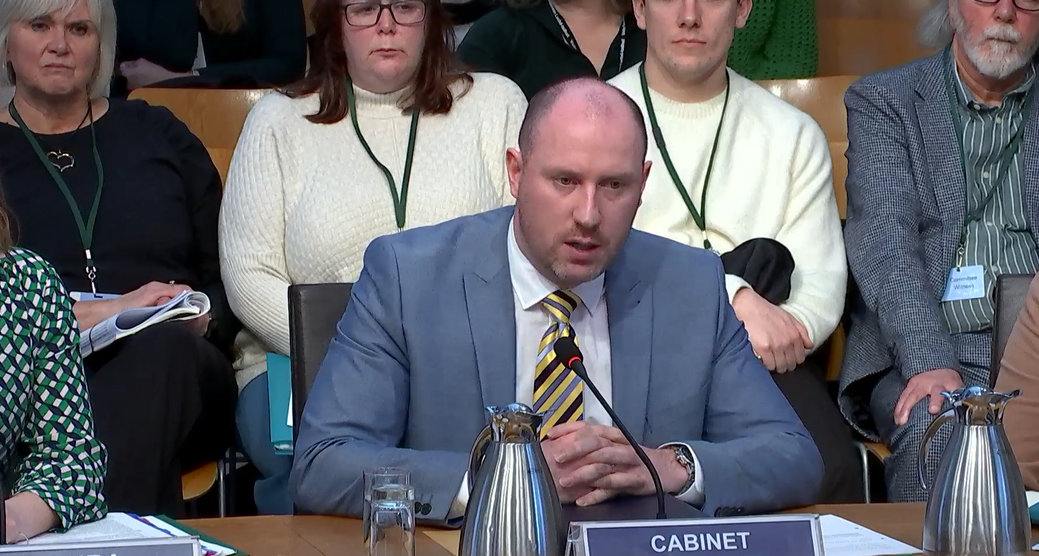
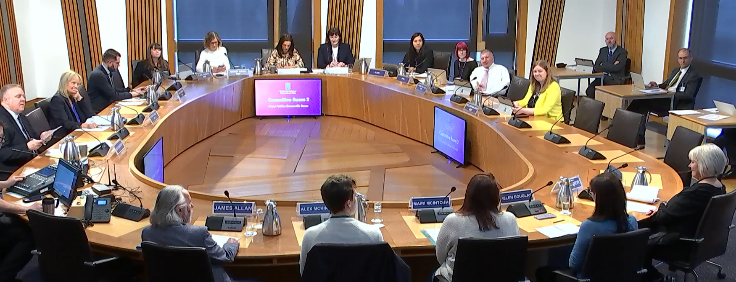
2 What mechanisms does the Scottish Parliament use to ensure citizen recommendations are acted upon?
Tracking and reporting the recommendations widely
Holding Government to account
Amending Legislation
Delivering a model for parliamentary scrutiny of climate change: a Climate Change People’s Panel – SPICe Spotlight | Solas air SPICe
Amendment 8 which requires ministers to set out in a statement to Parliament their plans for public consultation on future climate change plans

Slide 8
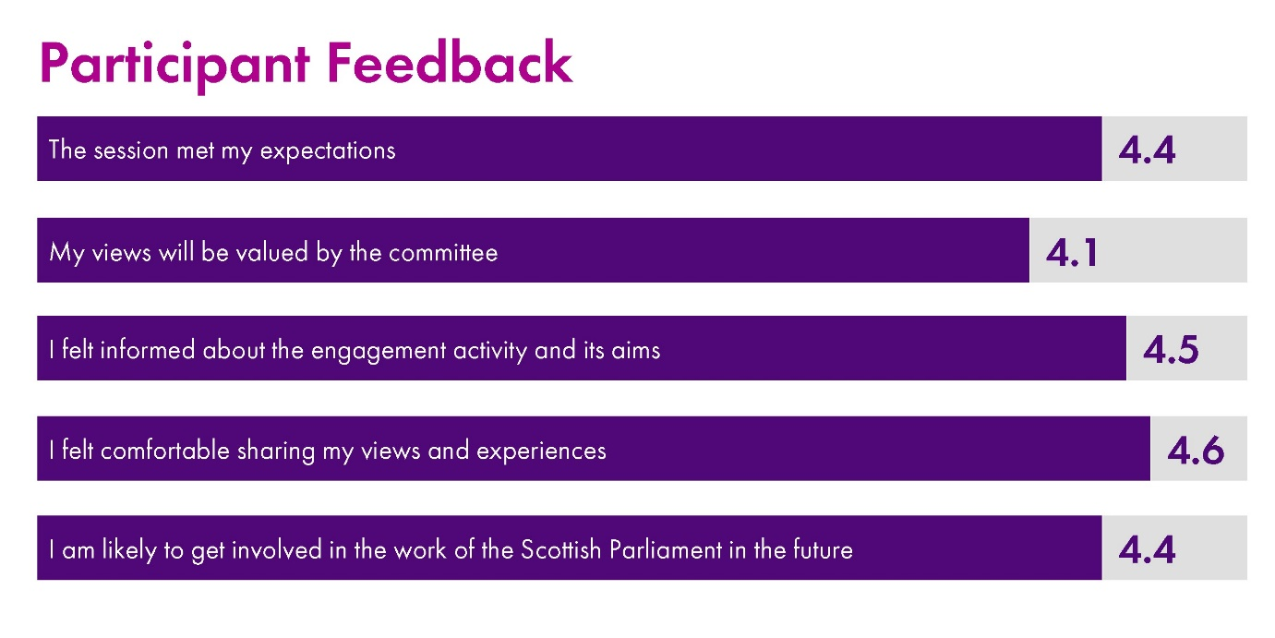
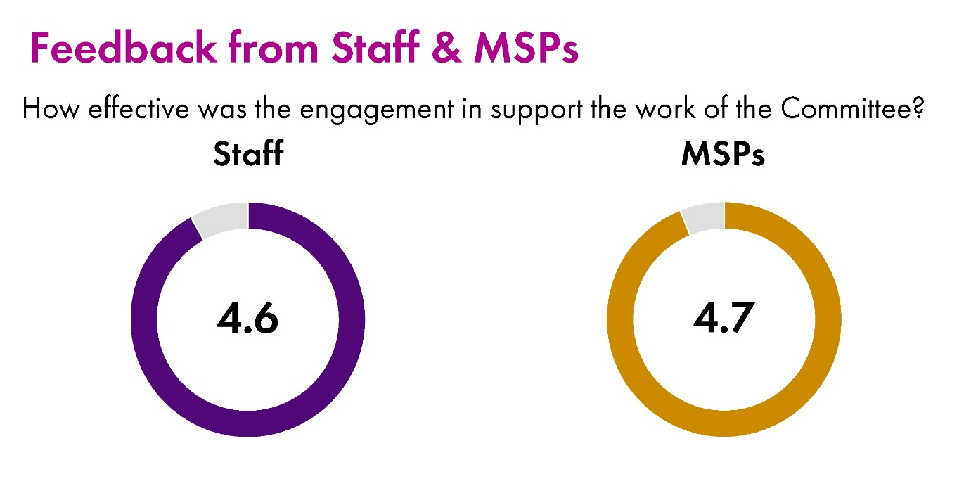
PACT Evaluation - Measuring impact
Consistent evaluation of any participation with review
Consistent positive feedback from participants, partners, MSPs and SP colleagues
Contribute to strategic objectives of Parliament and Key Performance Indicators
EG Data currently feeding into a Communities Strategy

Slide 9
3 What best practices could Albania adopt?
Our Learning has highlighted the need for:
Consistent evaluation – external evaluation of panels and participation to date has consolidated the learning and continuous improvement processes
Ambassadors – bringing internal teams on board – keeping well connected with external partners – training other interested staff to assist in facilitation and delivery of panels
Linking into wider participation – inhouse team has range of skills including; community development approaches, facilitation, workshop design, experience of co-production
Working collaboratively – inhouse co-production
Being comfortable with experimentation and testing

